Slide 1
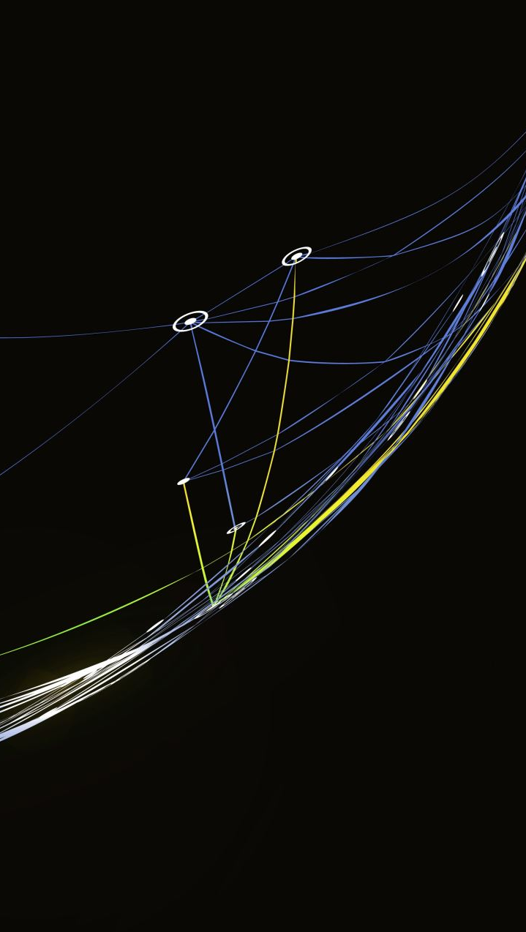
CHATGPT TRAVEL CHATBOT
Revati Lachyan

Slide 2
Introduction
The task involves creating a chatbot for a travel agent company, merging the front-end UI client with a ChatGPT-based backend.
The project aims to create an intelligent and user-friendly system that not only understands the nuances of travel-related inquiries but also provides accurate and relevant information
Key functionalities include receiving diverse travel-related questions: Examples: Inquiring about the distance or flight time between two cities.
Exploring travel package options, specifically from locations like Mumbai or Hong Kong to London.

Slide 3
System components
ChatGPT-based Server:
Utilizes ChatGPT for natural language understanding.
Handles travel information queries with contextual awareness.
Travel Agent-Specific Database:
Stores detailed travel package information.
Vital for addressing user inquiries about specific travel arrangements.
Dynamic Query Handling:
Synergizes ChatGPT and the database for intelligent query interpretation.
Routes queries based on nature, ensuring seamless integration.
NL Query-SQL Engine:
Facilitates communication with the database.
Executes SQL queries generated from natural language.

Slide 4

classifier
Classifier Choice: MultinomialNB
Utilizes Multinomial Naive Bayes for text classification.
Trained on a diverse dataset of labeled queries.
Capable of distinguishing between travel information and travel package queries.
Training Data:
Dataset includes a mix of inquiries about distances, flight times, and travel packages.
Represents a broad spectrum of user inputs for robust model training.
Features Extraction:
Implements TF-IDF vectorization for effective feature extraction.
Converts textual queries into numerical representations for the classifier.
Performance Evaluation:
Assessed accuracy using metrics like accuracy_score.
Ensures the classifier effectively discerns user intents.

Slide 5
Backend Processing
Function is used to predict category of ‘Travel Information’ and ‘Travel Package’ according to MultinomialNB classifier.
Initialized ChatGPT context according to predicted category.
NLP query runs according to the provided context.

Slide 6
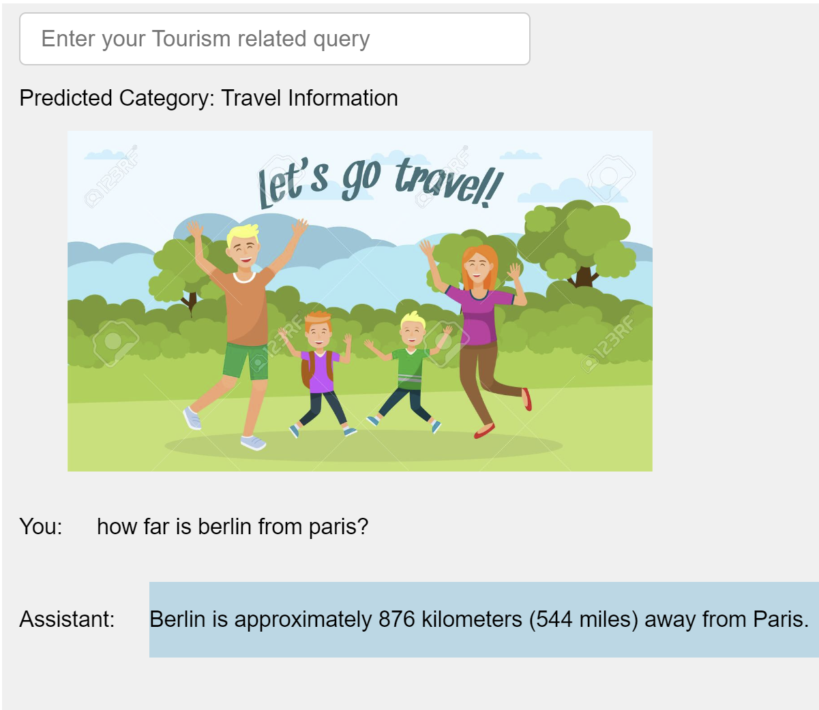
Results

Slide 7
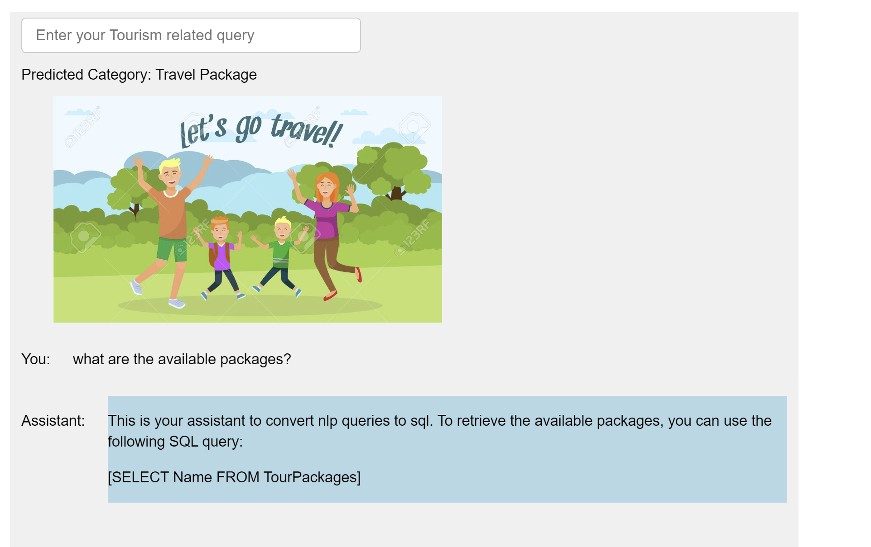
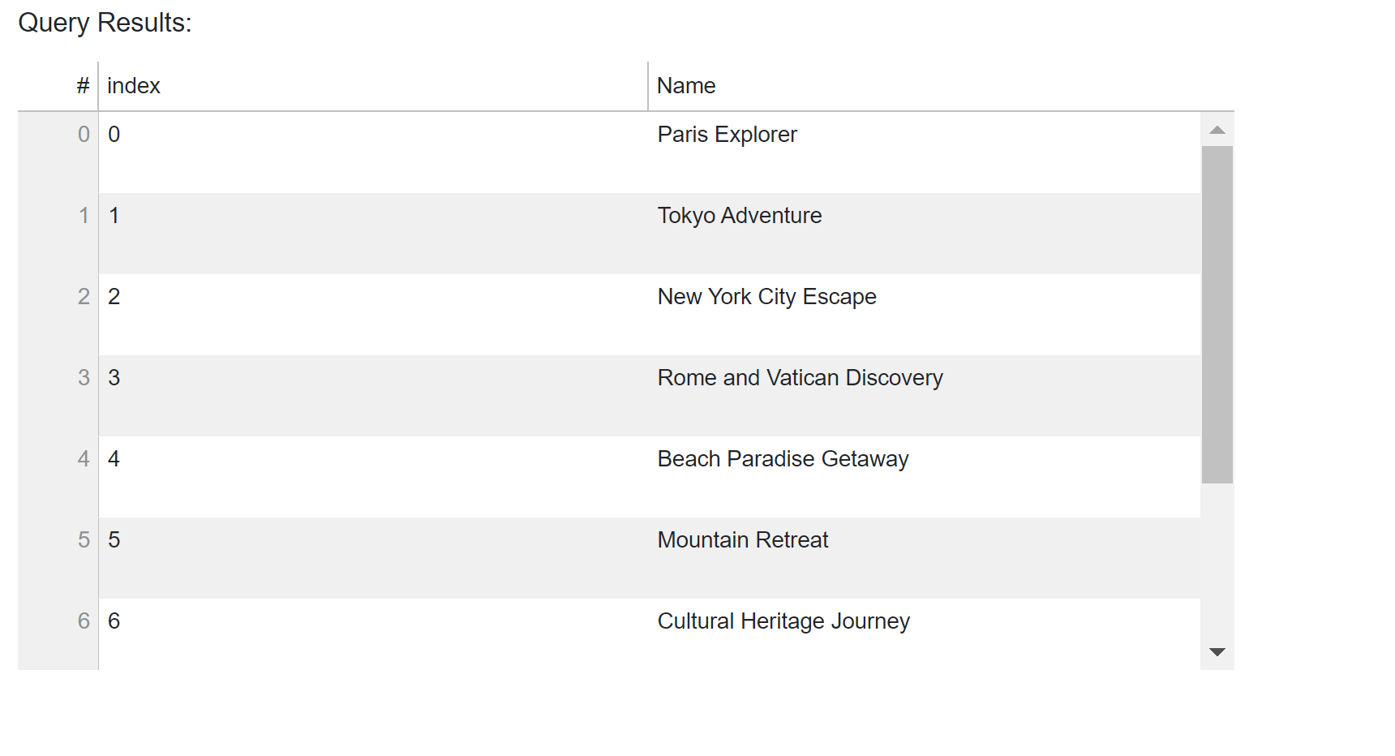
Results

